Slide 1

ANÁLISIS DE DATOS ESPACIALES
EDIER V. ARISTIZÁBAL G.
Ing. Geólogo (Universidad Nacional de Colombia)
Esp. en Gestión de Riesgos Geológicos (Universidad de Ginebra – Suiza)
MSc. en Geociencias (Universidad de Shimane – Japón)
PhD. en Ingeniería (Universidad Nacional de Colombia)
Universidad Nacional de Colombia
Facultad de Minas
Departamento de Geociencias

Slide 2
REGRESIÓN LOGÍSTICA

Slide 3

REGRESION LINEAL
Variable dependiente= ocurrencia de MenM
Variables independientes = Geología, pendiente, uso del suelo, etc

Slide 4
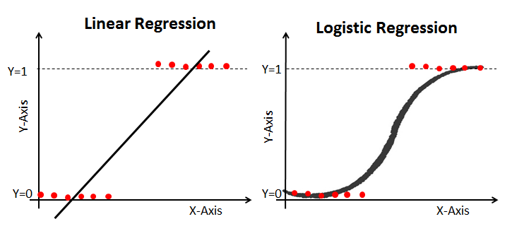
LOGIT

Slide 5
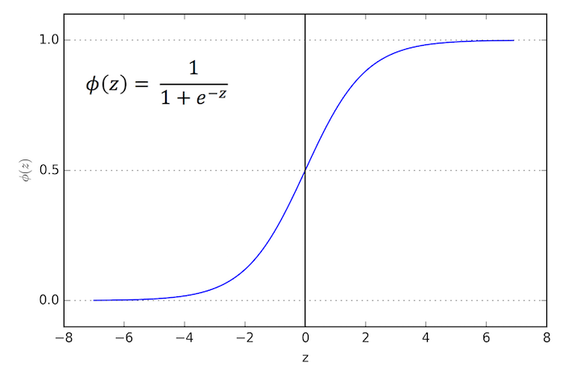
LOGIT

Slide 6
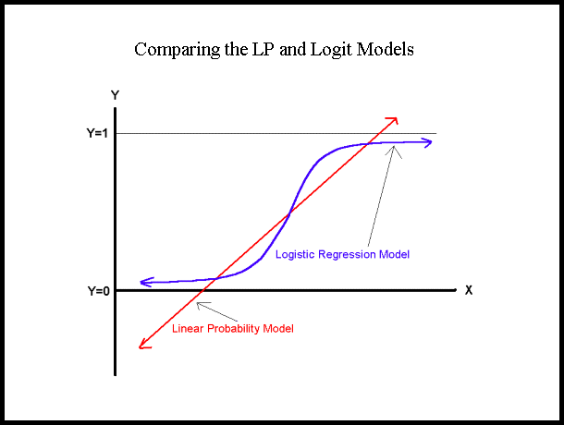
REGRESION LOGISTICA
La Regresión Logística es una combinación lineal de variables independientes (factores explicativos) para explicar la varianza en una variable dependiente tipo dummy [0 – 1].
Probabilidad de la variable dependiente
Relación lineal en función de las variables independientes

Slide 7
REGRESION LOGISTICA
Ventajas:
Las variables predictoras pueden ser continuas, discretas, dicótomas, o cualquier combinación de ellas.
La variable dependiente es dicotoma
No requiere distribución normal de las variables
Desventajas
Los pesos de las variables terminan siendo un promedio para toda el área de estudio, los cuales en realidad pueden diferir en diferentes partes del área de estudio.
Los resultados de la Regresión Logística son evaluados utilizando:
No existe un R²
R² de Cox & Snell
R² de Nagelkerke.

Slide 8
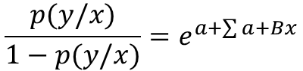
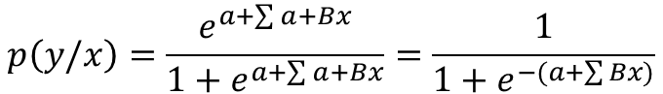
REGRESION LOGISTICA
Sea p(y/x) la probabilidad de éxito cuando el valor de la variable predictora es x, & (1-p(x)) la probabilidad de no ocurrencia, entonces :
$$p\left(y/x\right)=\frac{e^{a+\sum{a+Bx}}}{1+e^{a+\sum{a+Bx}}}=\frac{1}{1+e^{−(a+\sum{Bx)}}}$$
$$\frac{p(y/x)}{1−p(y/x)}=e^{a+\sum{a+Bx}}$$
[range=0 to 1]
[range=0 to ∞]

Slide 9
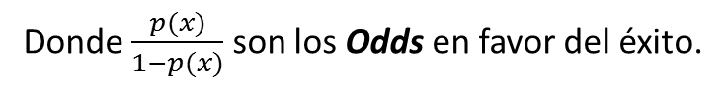
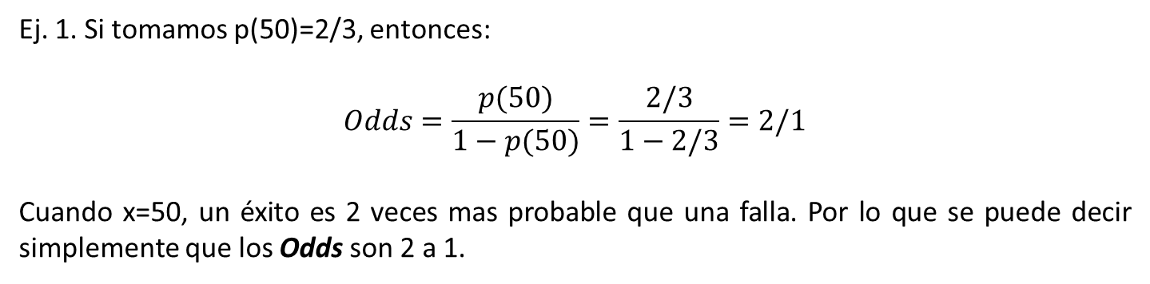
ODDS
Donde $\frac{p(x)}{1−p(x)}$ son los Odds en favor del éxito.
Ej. 1. Si tomamos p(50)=2/3, entonces:
$$Odds=\frac{p(50)}{1−p(50)}=\frac{2/3}{1−2/3}=2/1$$
Cuando x=50, un éxito es 2 veces mas probable que una falla. Por lo que se puede decir simplemente que los Odds son 2 a 1.

Slide 10
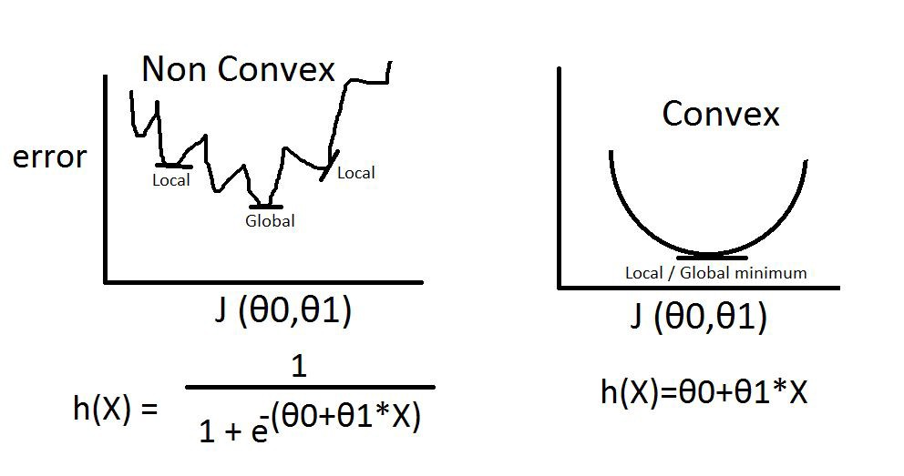
Limitaciones de los ODDS

Slide 11
Limitaciones de los ODDS
No es equitativo
0
1
+∞
(d>n/d)
(n>d/d)
0,0018
566,67
3/1700
1700/3
-∞
log(d>n/d)
0
log(n>d/d)
+∞
-2,75
2,75
Log(3/1700)
Log(1700/3)

Slide 12
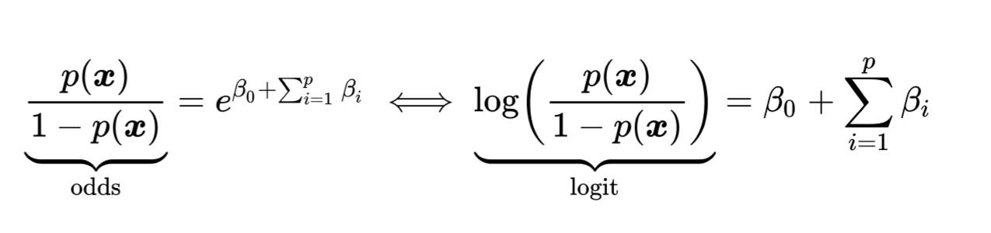
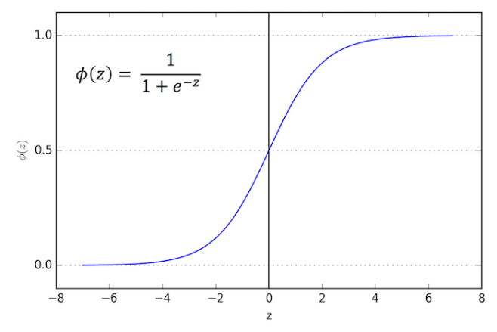
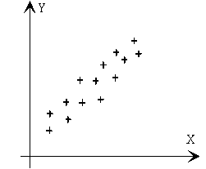
Limitaciones de los ODDS
Logit
Regresión Lineal

Slide 13
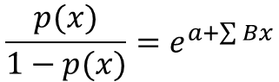
REGRESION LOGISTICA
La relación de un evento de dos clases y su dependencia con el grupo de variables predictoras es igual al logaritmo de la razón de Odds:
Odds →
$$\frac{p(x)}{1−p(x)}=e^{a+\sum{Bx}}$$
Log odds “logit” →
[range=0 to ∞]
[range=-∞ to +∞]
Donde B_{o} es el intercepto del modelo, B_{n} son los coeficientes del modelo de regresión logística, y v_{n} son las variables independientes (predictoras) y E es el error.
[range=0 to 1]
Donde, P es la probabilidad de Bernoulli que una unidad de terreno pertenece al grupo de si o al grupo no. P varía de 0 a 1 en forma de curva “S” (logística).

Slide 14
REGRESION LOGISTICA
Binaria
Continua acotada
Continua positiva
Continua infinita

Slide 15
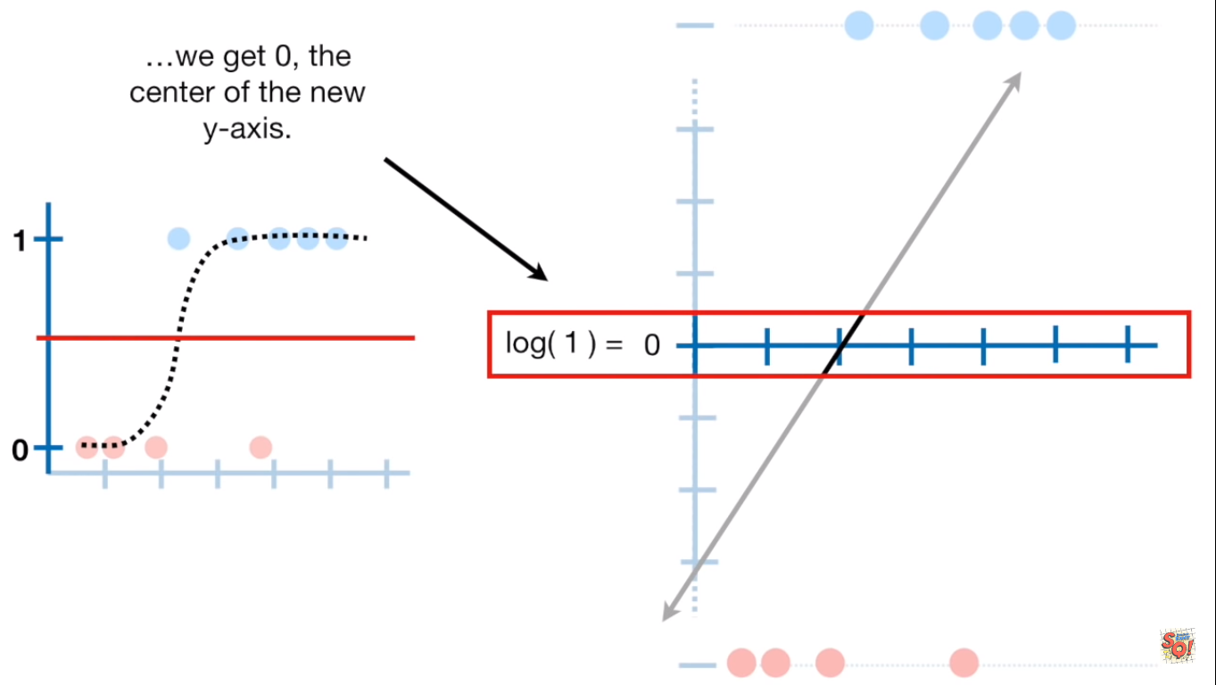
UMBRAL
Y > 0
P=0,5
Y < 0

Slide 16
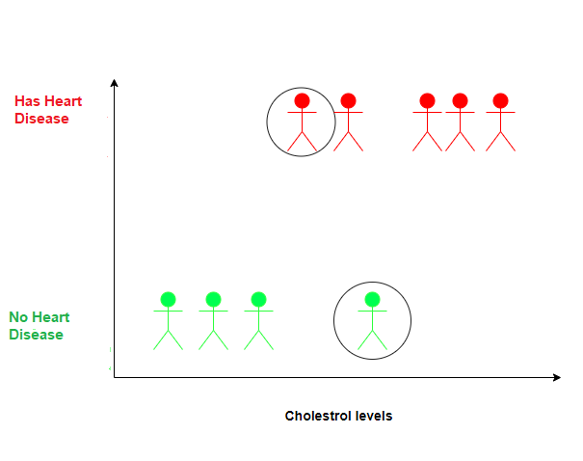
UMBRAL

Slide 17
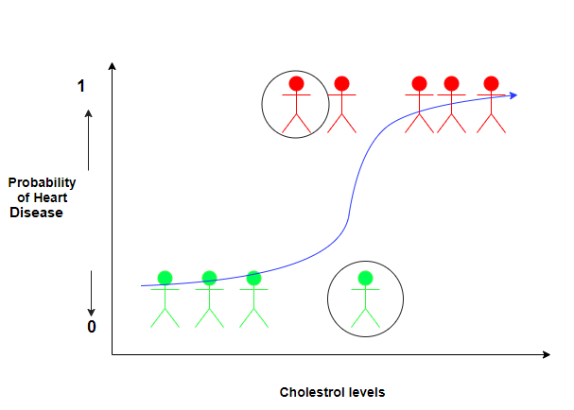
UMBRAL

Slide 18
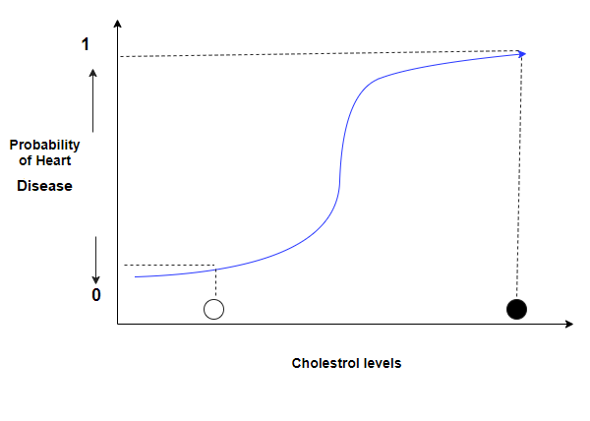
UMBRAL

Slide 19
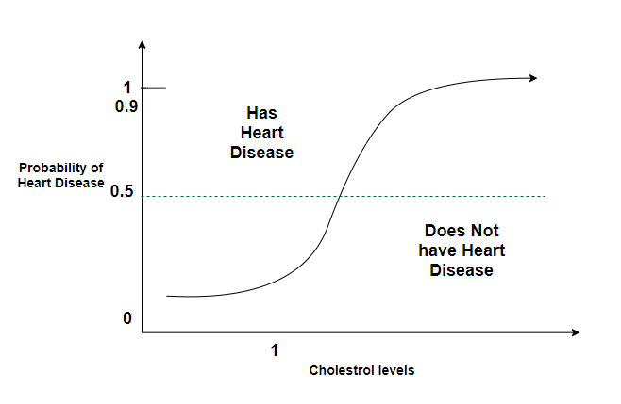
UMBRAL

Slide 20
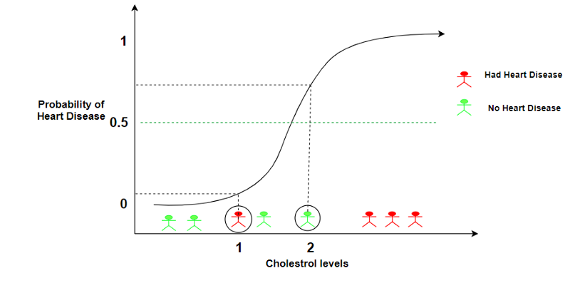
UMBRAL

Slide 21
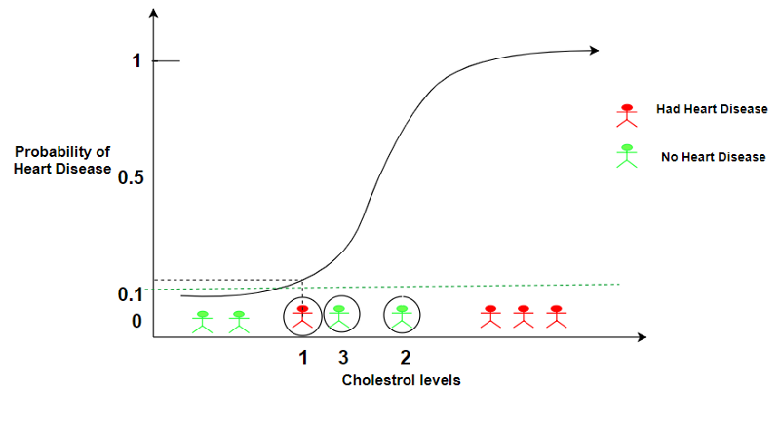
UMBRAL

Slide 22
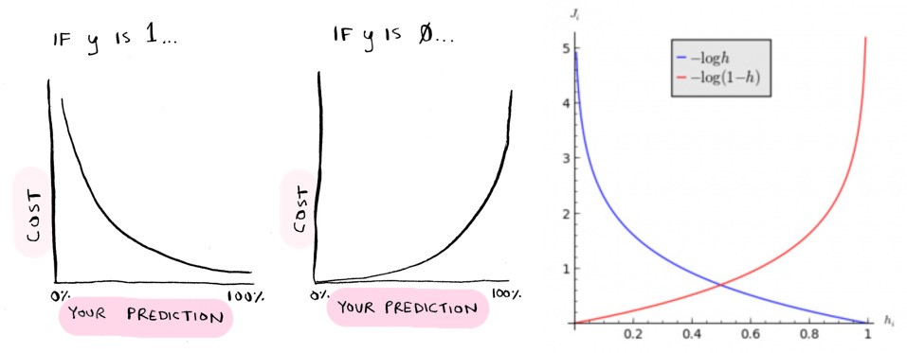
FUNCIÓN DE COSTO

Slide 23
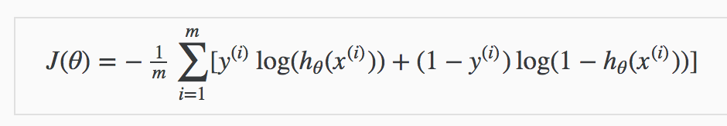
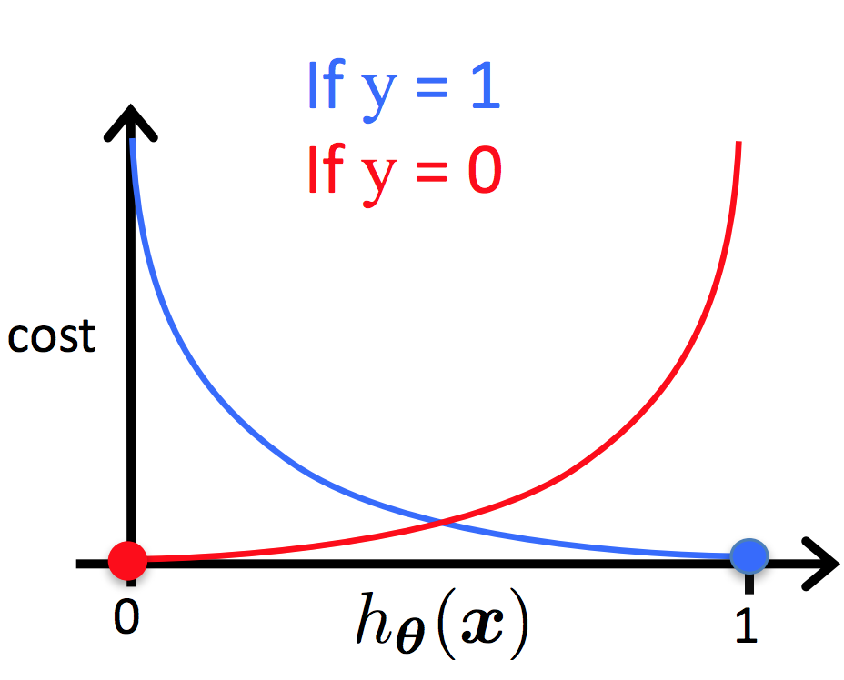
FUNCIÓN DE COSTO

Slide 24
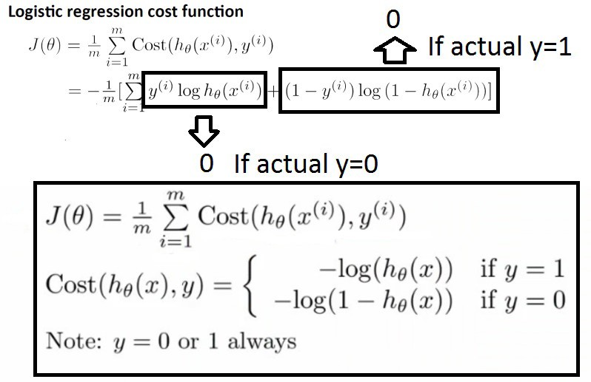
FUNCIÓN DE COSTO

Slide 25
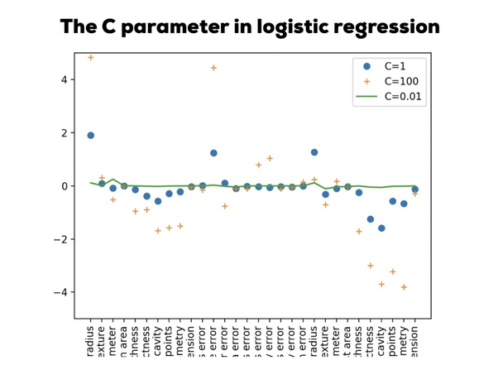
HIPERPARÁMETRO
Parameter C = 1/λ.

Slide 26
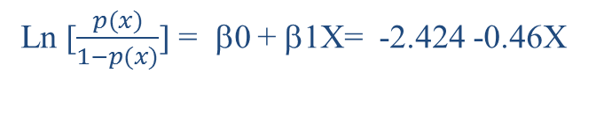
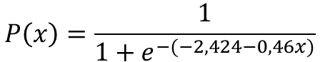
INTERPRETACIÓN
Pendiente
Pendiente < 20
Pendiente > 20
No MenM
MenM
Pendiente
Ln [$\frac{p(x)}{1−p(x)}$] = β0 + β1X= -2.424 -0.46X
Cambio en odds = e^{-.46} =.63
$$P\left(x\right)=\frac{1}{1+e^{−(−2,424−0,46x)}}$$
Cambio en los Odds: que en una ladera con pendiente > 20 ocurra un MenM es 0.63 comparado con otras laderas. Es decir es menos probable.
Cual es la probabilidad de un MenM con o sin pendiente >20?

Slide 27
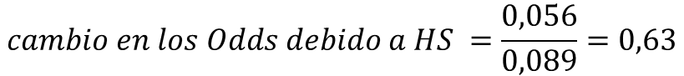
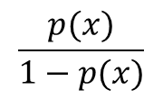
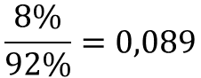
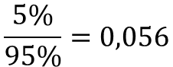
INTERPRETACIÓN
Pendiente
Pendiente < 20
Pendiente > 20
No MenM
MenM
$$\frac{p(x)}{1−p(x)}$$
→
$$\frac{8\%}{92\%}=0,089$$
→
92%
8%
95%
5%
→
$$\frac{5\%}{95\%}=0,056$$
$$Odds en MenM con pendiente>20=\frac{{33}/{623}}{{590}/{623}}=\frac{33}{590}=0,056$$
$$Odds en MenM con pendiente<20=\frac{{45}/{553}}{{508}/{553}}=\frac{45}{508}=0,089$$
$$cambio en los Odds debido a HS =\frac{0,056}{0,089}=0,63$$
$$Coeficiente de regresión logistica=ln \left(0,63\right)=−0,46$$

Slide 28
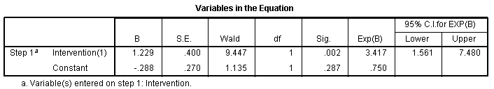
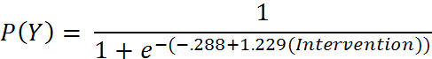
REGRESION LOGISTICA
Se puede decir entonces que los cambios en los Odds de un paciente que es tratado y ha sido curado es 3,41 veces mayor que aquellos pacientes que no fueron tratados, con un 95% CI de 1.561 a 7.480.

Slide 29
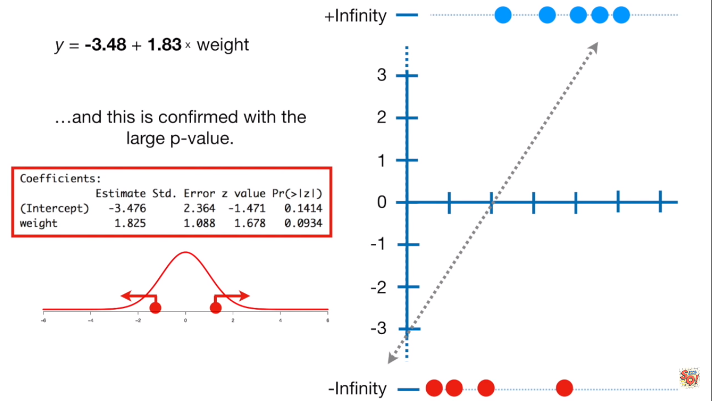
INTERPRETACIÓN

Slide 30
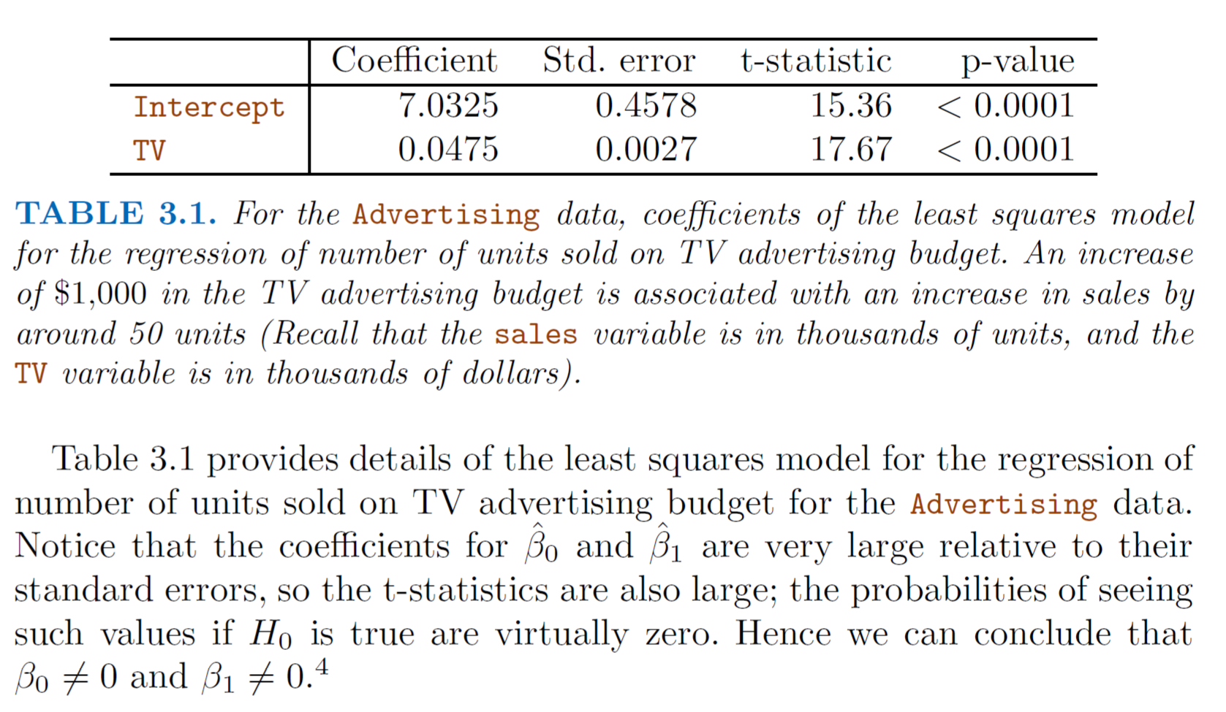
INTERPRETACION

Slide 31
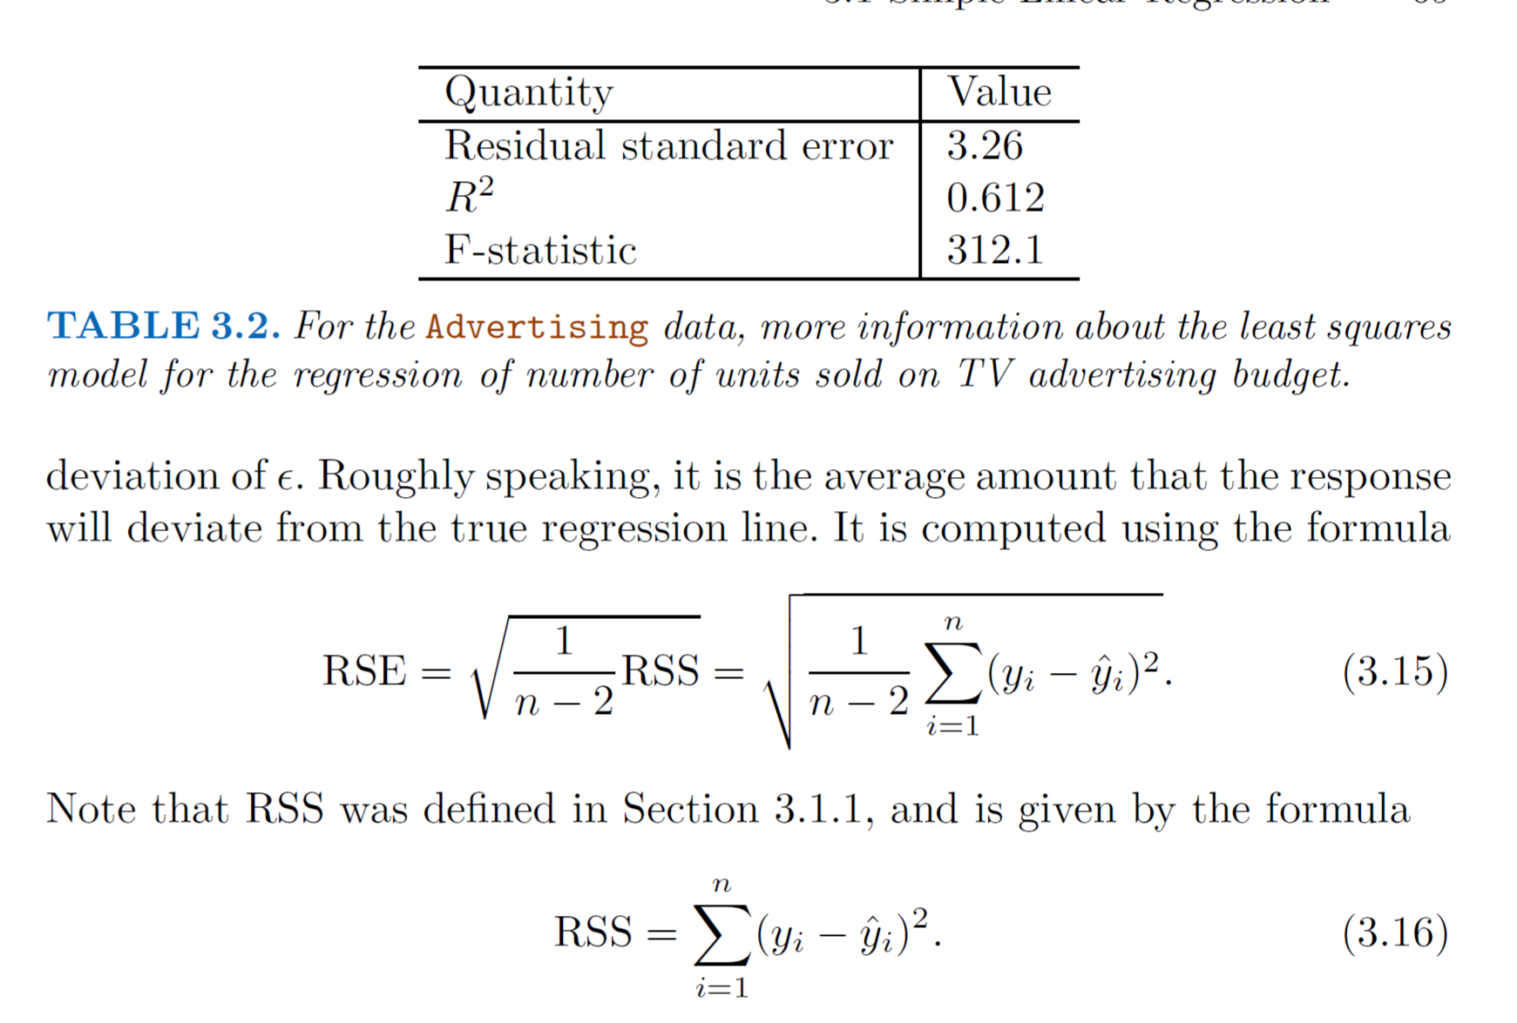
INTERPRETACION
In the case of the advertising data, we see from the linear regression output in Table that the RSE is 3.26. In other words, actual sales in each market deviate from the true regression line by approximately 3,260 units, on average. Of course, whether or not 3,260 units is an acceptable prediction error depends on the problem context. In the advertising data set, the mean value of sales over all markets is approximately 14,000 units, and so the percentage error is 3,260/14,000 = 23%

Slide 32
INTERPRETACION
Standard errors can be used to compute confidence intervals. A 95% confidence interval is defined as a range of values such that with 95% interval probability, the range will contain the true unknown value of the parameter. The range is defined in terms of lower and upper limits computed from the sample of data.
In the case of the advertising data, the 95% confidence interval for β0 is [6.130, 7.935] and the 95% confidence interval for β1 is [0.042, 0.053].
Therefore, we can conclude that in the absence of any advertising, sales will, on average, fall somewhere between 6,130 and 7,940 units. Furthermore, for each $1,000 increase in television advertising, there will be an average increase in sales of between 42 and 53 units

Slide 33
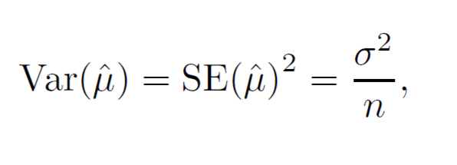
INTERPRETACION
Standard errors can also be used to perform hypothesis tests on the hypothesis coefficients. The most common hypothesis test involves testing the null test hypothesis of null hypothesis
H0 : There is no relationship between X and Y, versus the alternative hypothesis Ha : There is some relationship between X and Y .
Mathematically, this corresponds to testing
H0 : β1 = 0 versus Ha : β1 = 0,
since if β1 = 0 then the model reduces to Y = β0 + , and X is not associated with Y . To test the null hypothesis, we need to determine whether ˆ β1, our estimate for β1, is sufficiently far from zero that we can be confident that β1 is non-zero.
How far is far enough? This of course depends on the accuracy of ˆ β1—that is, it depends on SE( ˆ β1). If SE( ˆ β1) is small, then even relatively small values of ˆ β1 may provide strong evidence that β1 = 0, and hence that there is a relationship between X and Y . In contrast, if SE( ˆ β1) is large, then ˆ β1 must be large in absolute value in order for us to reject the null hypothesis. In

Slide 34
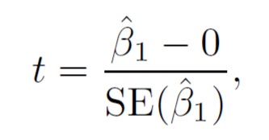
INTERPRETACION
we compute a t-statistic,
which measures the number of standard deviations that ˆ β1 is away from 0. If there really is no relationship between X and Y , then we expect that will have a t-distribution with n−2 degrees of freedom. The t distribution has a bell shape and for values of n greater than approximately 30 it is quite similar to the normal distribution. Consequently, it is a simple matter to compute the probability of observing any number equal to |t| or larger in absolute value, assuming β1= 0. We call this probability the p-value.
Roughly speaking, we interpret the p-value as follows: a small p-value indicates that it is unlikely to observe such a substant dictor and the response due to chance, in the absence of any real association then we can infer that there is an association between the predictor and the response. We reject the null hypothesis—that is, we declare a relationship to exist between X and Y —if the p-value is small enough. Typical p-value cutoffs for rejecting the null hypothesis are 5 or 1%

Slide 35
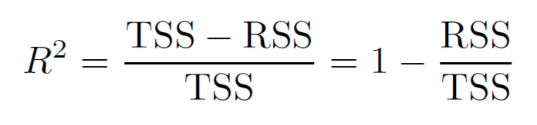
INTERPRETACION
The R2 statistic provides an alternative measure of fit. It takes the form of a proportion—the proportion of variance explained—and so it always takes on a value between 0 and 1, and is independent of the scale of Y . where TSS = (yi − ¯y)2 is the total sum of squares, and RSS is defined total sum. TSS measures the total variance in the response Y , and can be squares thought of as the amount of variability inherent in the response before the regression is performed. In contrast, RSS measures the amount of variability that is left unexplained after performing the regression. Hence, TSS−RSS measures the amount of variability in the response that is explained (or removed) by performing the regression, and R2 measures the proportion of variability in Y that can be explained using X. An R2 statistic that is close to 1 indicates that a large proportion of the variability in the response has been explained by the regression. A number near 0 indicates that the regression did not explain much of the variability in the response

Slide 36
INTERPRETACION
The F-statistic for the multiple linear regression model obtained by regressing sales onto radio, TV, and newspaper is shown in Table 3.6. In this example the F-statistic is 570. Since this is far larger than 1, it provides compelling evidence against the null hypothesis H0. In other words, the large F-statistic suggests that at least one of the advertising media must be related to sales. However, what if the F-statistic had been closer to 1? How large does the F-statistic need to be before we can reject H0 and conclude that there is a relationship? It turns out that the answer depends on the values of n and p. When n is large, an F-statistic that is just a little larger than 1 might still provide evidence against H0. In contrast, a larger F-statistic is needed to reject H0 if n is small.

Slide 37
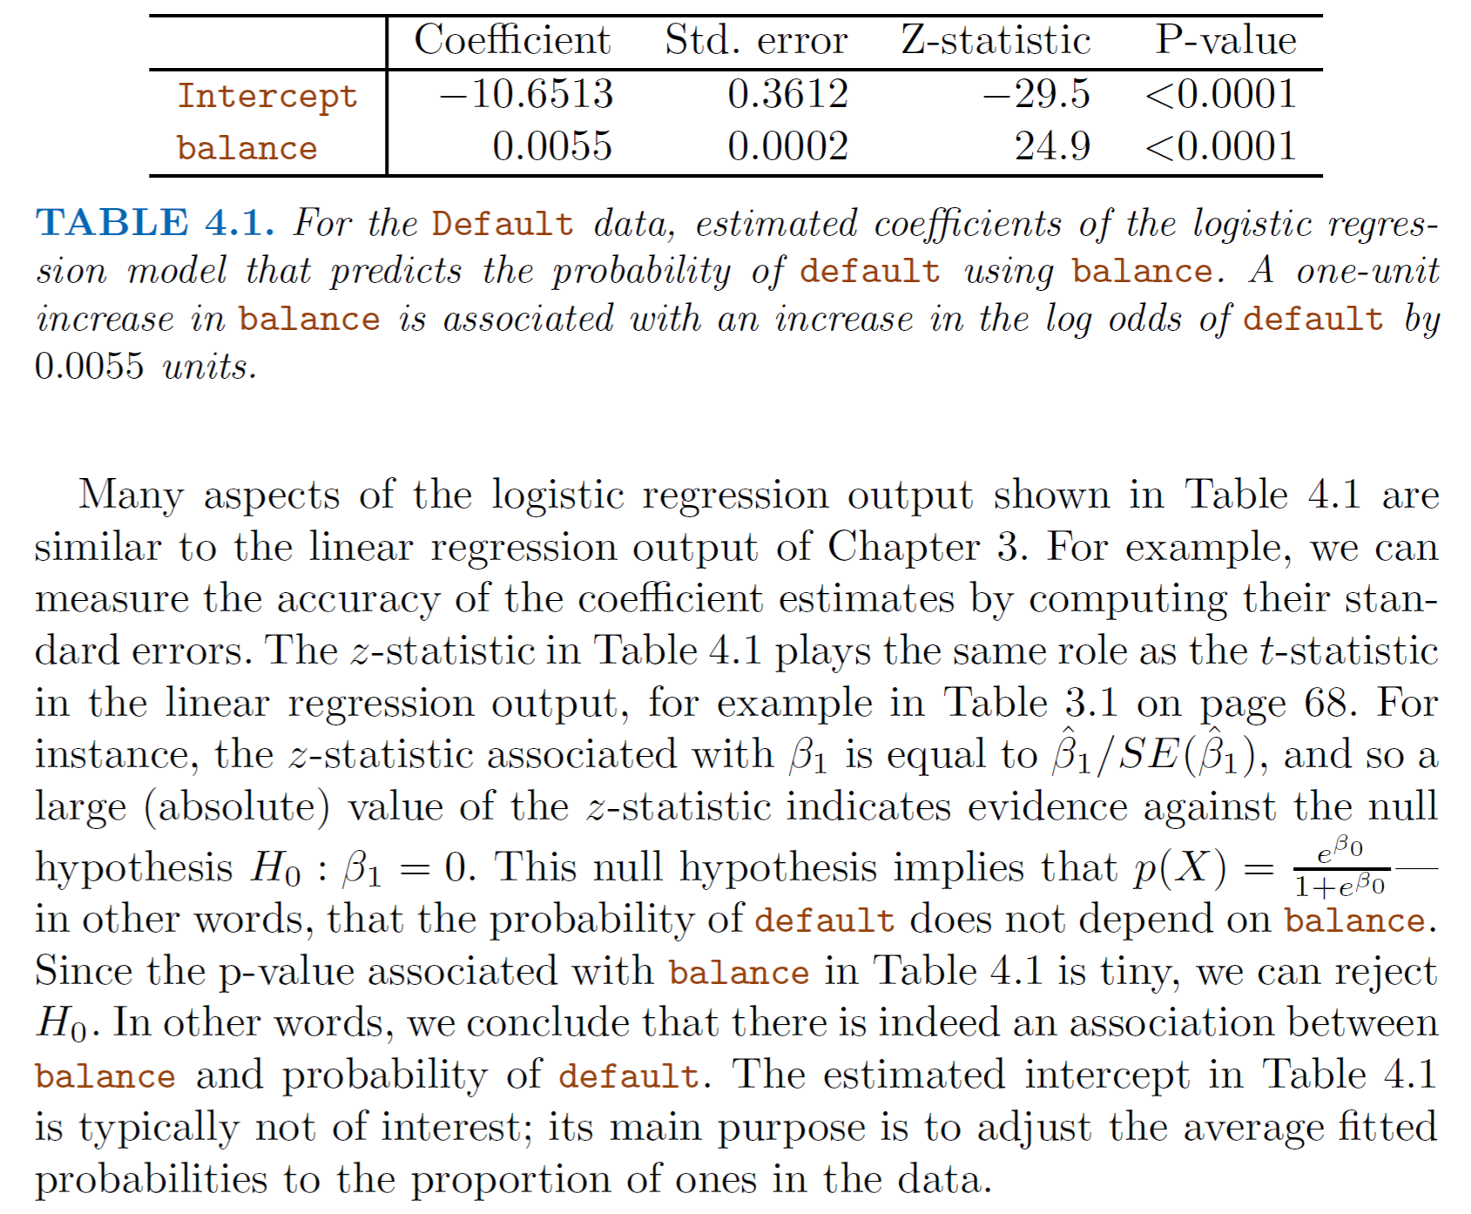

Slide 38
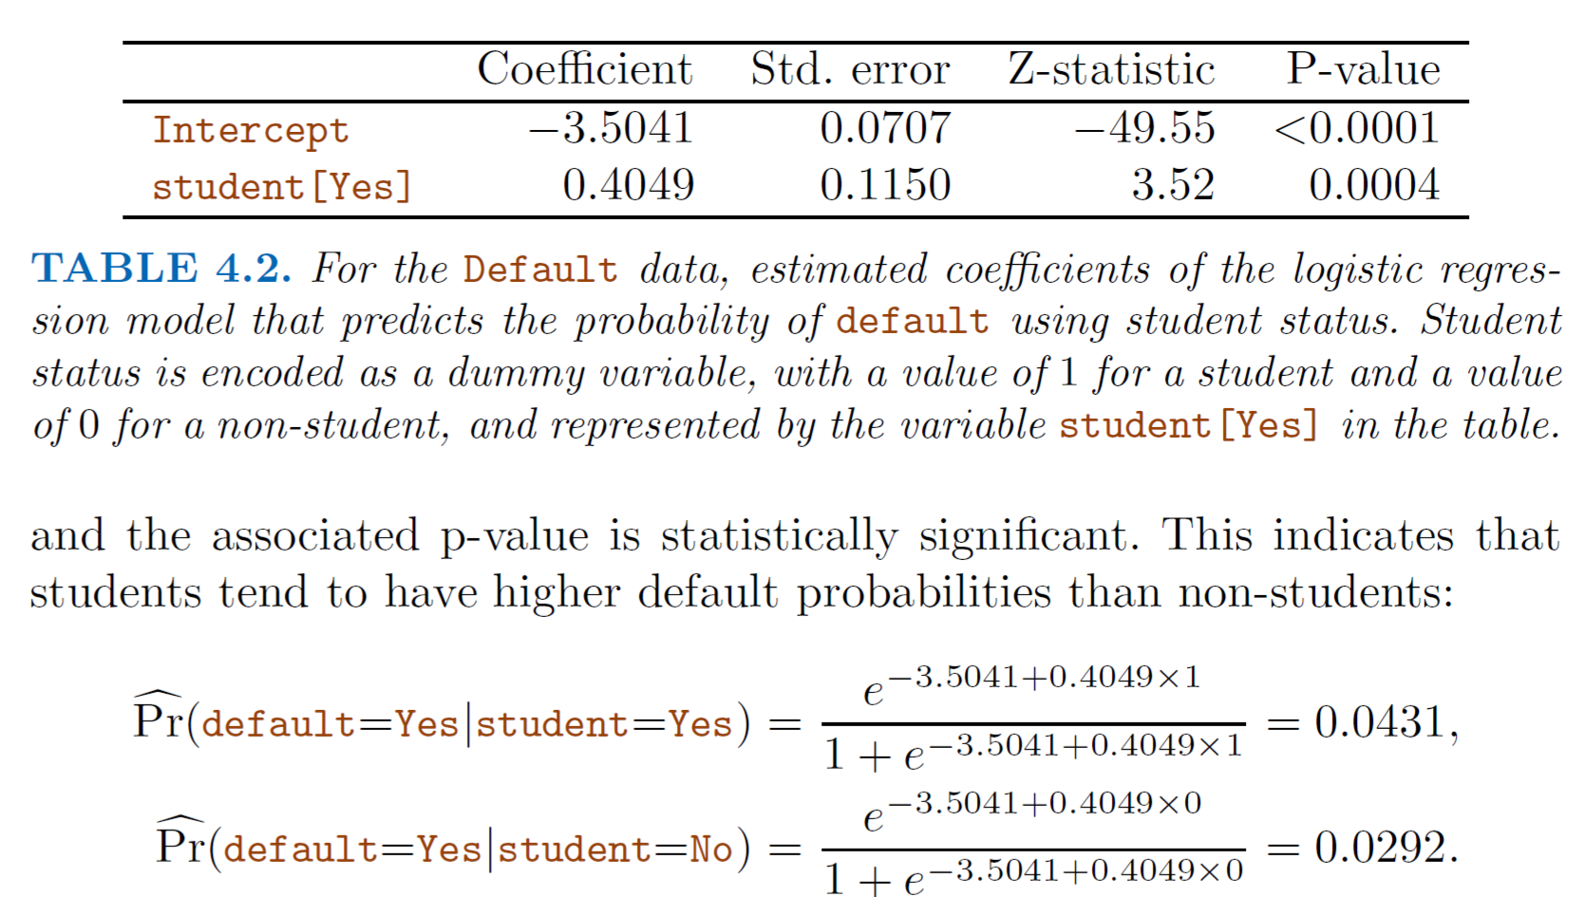
INTERPRETACION

Slide 39
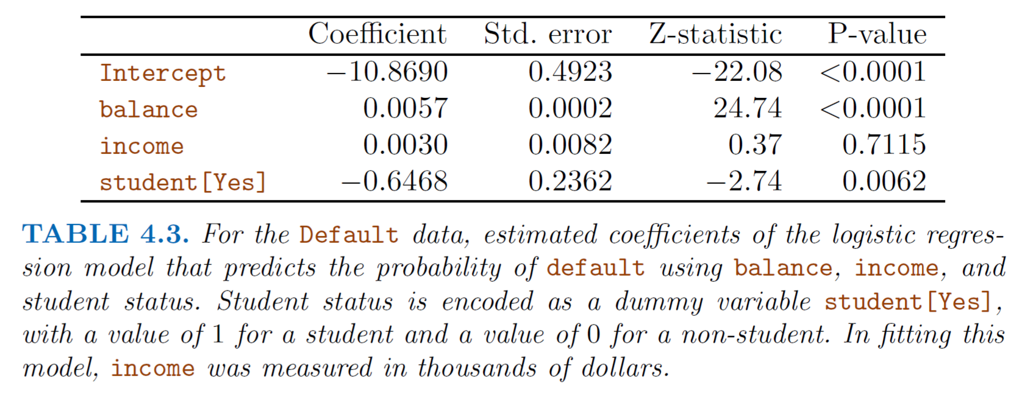
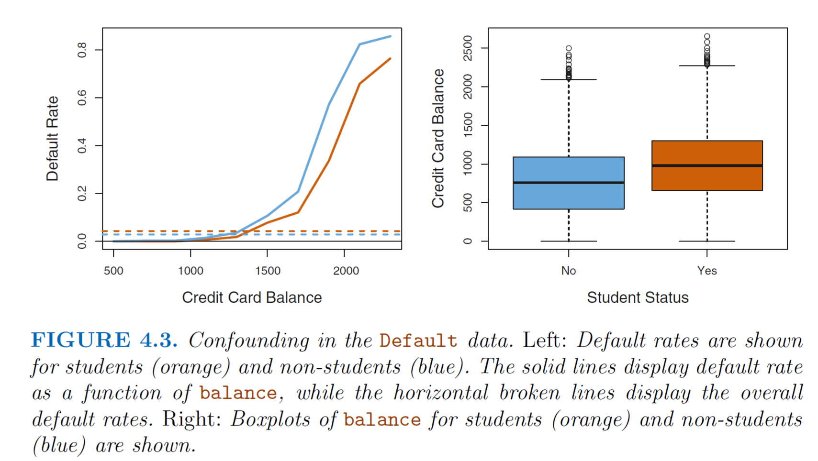

Slide 40
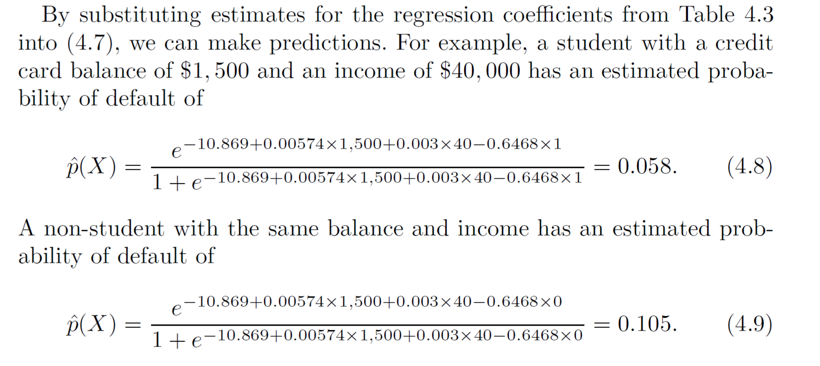
INTERPRETACION

Slide 41
INTERPRETACION
Fuente: Chen et al (2016), río Yangtze (China)

Slide 42
TÉCNICA APLICADA: Regresión Logística
Fuente: Chen et al, (2016) en el río Yangtze (China)

